Slide 1
Minnesota Ground Water Association
Ellen J. Considine, President
Notes:
Thank you Mr. Chairman and members. I am here today with Kristen Blann and Andrew Streitz representing the Minnesota Ground Water Association. MGWA is a non-profit (501(c)), volunteer organization of about 500 members. We were founded in 1982. MGWA’s focus is not a field of study, like engineering or law, but rather our ground water resource. As such our members are scientists, engineers, planners, educators, and policy/law experts.

Slide 2
MGWA’s objectives:
Study and understand Minnesota’s ground water resources;
Find solutions to ground water issues;
Contribute to the development of state-wide ground water protection strategies;
Promote the wise use of Minnesota’s ground water resources for the future;
Educate students of all ages and the general public;
Encourage the sciences of ground water hydrology and hydrogeology.
Notes:
MGWA was founded to bring together members of various professions and the general public in order to:

Slide 3
MGWA White Papers
Goal: provide an unbiased evaluation of a ground water issue.
Manganese in Minnesota’s Groundwaters
Minnesota’s Groundwater Education Gap
Drain Tiles and Groundwater Resources
Chloride and Stormwater Infiltration (in preparation)
Notes:
In 2014 MGWA convened a volunteer committee to prepare the first white paper: about manganese in Minnesota’s groundwater. Since then three additional committees have formed to work on additional white papers. Kristen Blann was an author of the drain tile white paper, and Andrew Streitz was a liasion between the white paper committee and MGWA’s board, and they are here today to provide you with a summary of the committee’s findings.

Slide 4
Drain Tiles and Groundwater Resources:
Understanding the relations

Slide 5
MGWA Scoping Document
The use of drainage tile (“tile”) in Minnesota has historically allowed farmers better access to their fields to plant and till, leading to increasing yields.
MDA staff estimate ~30% of cropland is drained by tile and use of drainage is continually expanding.
The extent of tile drainage is not systematically documented or tracked
Tiling systems lower the water table in fields by intercepting shallow infiltration and discharging it to surface water. However, the impacts to water budgets and groundwater resources are largely unknown because it has mostly not been studied or modeled.
As demand for water increases for all uses, it is critical that we understand how our practices are affecting Minnesota’s water resources.
Notes:
Subsurface “tile” drainage is used extensively in Minnesota (~30% of cropland currently, and increasing every year) to lower the water table in fields which allows farmers earlier and better access as well as generally increasing yields by preventing crop damage from root saturation.
By intercepting shallow infiltration (lowering the water table over large areas) and discharging to surface water, tile drainage has the potential to substantially alter system hydrology and water budgets.
Identify areas or regions of the state most affected by the increase in tiling and the increase in irrigation in the context of costs and benefits.
Describe barriers to communication and understanding related to tiling and groundwater resources (for example, is there a common understanding about whether tile drainage is groundwater or surface water?).
Identify knowledge gaps/research opportunities related to understanding the effects tiling has on groundwater quantity, quality, and other water resource quantity and quality.

Slide 6
MGWA Tile & Groundwater Committee
Agricultural drainage white paper authors:
• Erik Smith, Ph.D., U.S. Geological Survey, lead writer
• Timothy Gillette, P.E., Minnesota Board of Water and Soil Resources, chairperson
• Kristen Blann, The Nature Conservancy
• Mary Coburn, Minnesota Department of Natural Resources
• Bryce Hoppie, Ph.D., Minnesota State University, Mankato
• Suzanne Rhees, Minnesota Board of Water and Soil Resources
Other agricultural drainage white paper work group members:
• Calvin Alexander, Ph.D., retired University of Minnesota professor
• Warren Formo, Minnesota Agricultural Water Resource Center
• Stephen Lorenz, P.G., consulting geologist
• Mark Morriem, independent tile drainage installer, past president of the Minnesota Land Improvement Contractors (MNLICA)
White paper committee liaisons:
• Melinda Erickson, Ph.D., U.S. Geological Survey
• Andrew Streitz, Minnesota Pollution Control Agency
Content Authorities:
• Al Kean, Minnesota Board of Water and Soil Resources
• Jeppe Kjaersgaard, Minnesota Department of Agriculture
• Dave Wall, Minnesota Pollution Control Agency
Notes:
I am just one of many committee members who contributed their knowledge and expertise and I would like to share that I am not an expert on groundwater . My interest in groundwater stems from the work I am engaged in as a freshwater ecologist from The Nature Conservancy in Minnesota on the importance of natural flow regimes for streams, rivers and lakes, and the importance of understanding how groundwater and surface water interact in these ecosystems to create the habitat template that supports our native freshwater and wetland ecosystems and communities. I am a lead author on a paper that explored the implications of subsurface as well as surface drainage and other hydrologic alterations for aquatic ecosystems, focusing on Minnesota and the Red River Valley. And I have also been involved in a multi-stakeholder and to develop criteria for sustaining groundwater and surface water environmental flows to support Minnesota’s native freshwater and groundwater dependent ecosystems. I’ll come back to this…

Slide 7
Executive Summary from white paper:
Long history (150+ years) of agricultural drainage in MN; distinct periods and needs ➔ complex and somewhat patchy regulatory/policy framework
~21% of Minnesota has some density of subsurface drainage
A basic understanding of aquifers and recharge is needed to hydrologic effects of drainage on groundwater.
“Tile drainage provinces” concept: overlay groundwater provinces with estimated tile drainage extent to aid discussion
Significant knowledge gaps and uncertainties ➔ need for / opportunities to improve understanding through research, studies, and modeling
Key need: better measures of groundwater recharge where drainage may potentially have impacts
Notes:
By draining saturated soils, tile drainage alters the water balance in croplands. The effect on groundwater has been poorly characterized; however, it is largely determined by the geology below drained areas and the arrangement of underlying aquifers.
“arrangement” – how connected are they? Close? Separated by aquitards? Is there a direct route for water to move between them?
Charge was to Summarize the history and current trends of tiling in Minnesota, including a map/database
Consult with subject matter experts, and review the scientific literature related to quantifying or otherwise describing the effect of drainage tile on groundwater resources…
Summarize the state of understanding related to tiling and groundwater:
Potential or measured changes to recharge to surficial and confined aquifers
Potential or measured changes to other relevant parts of the hydrologic cycle (i.e. stream flow, lakes, and wetlands.)
Potential or measured changes in water quality
Document the regulatory environment for tiling
Discuss the benefits and costs related to tiling
Identify knowledge gaps/opportunities for research

Slide 8
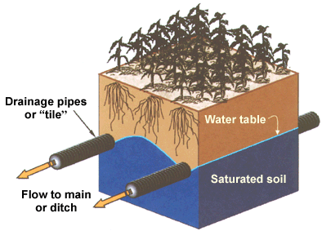
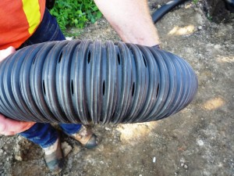
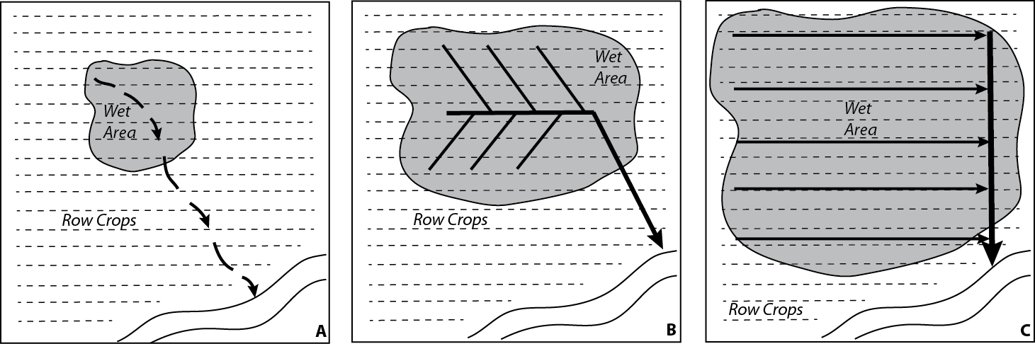
Notes:
Diagram of tile drainage , how it works

Slide 9
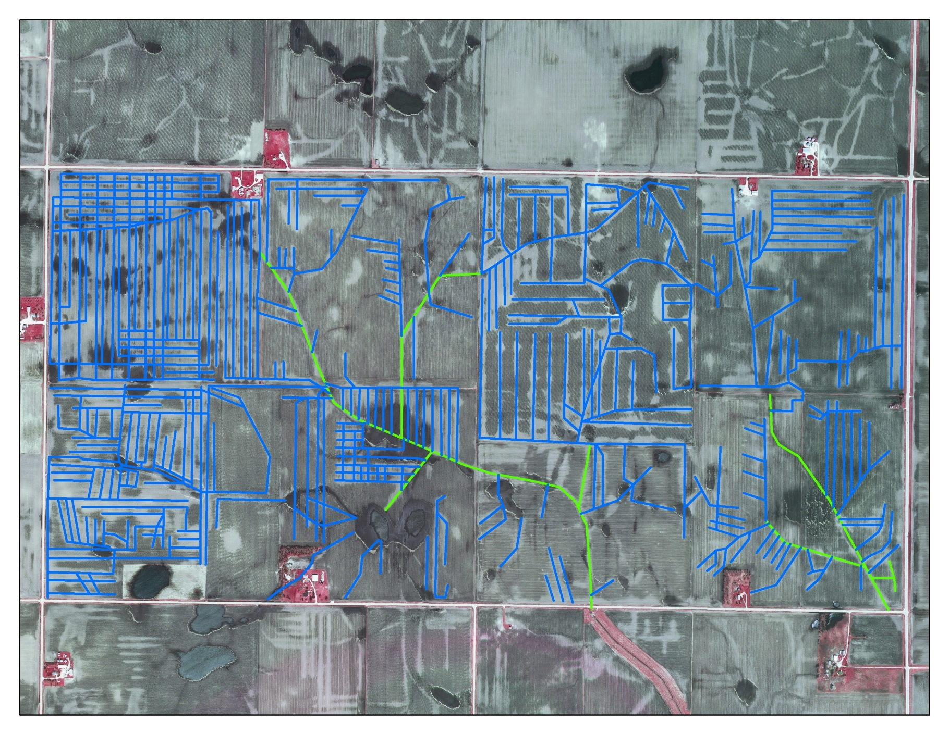
Color infrared aerial photography with tile lines digitized in blue and drainage district mains in green. Total length of tiles is approximately 56 miles; total drainage district main is 3 miles.
Notes:
What we know about how extensive it is across the landscape

Slide 10
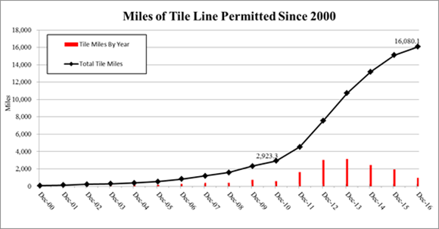
Miles of tile line permitted for the Bois de Sioux watershed, from 2000 to 2016 (Engels, 2017).

Slide 11
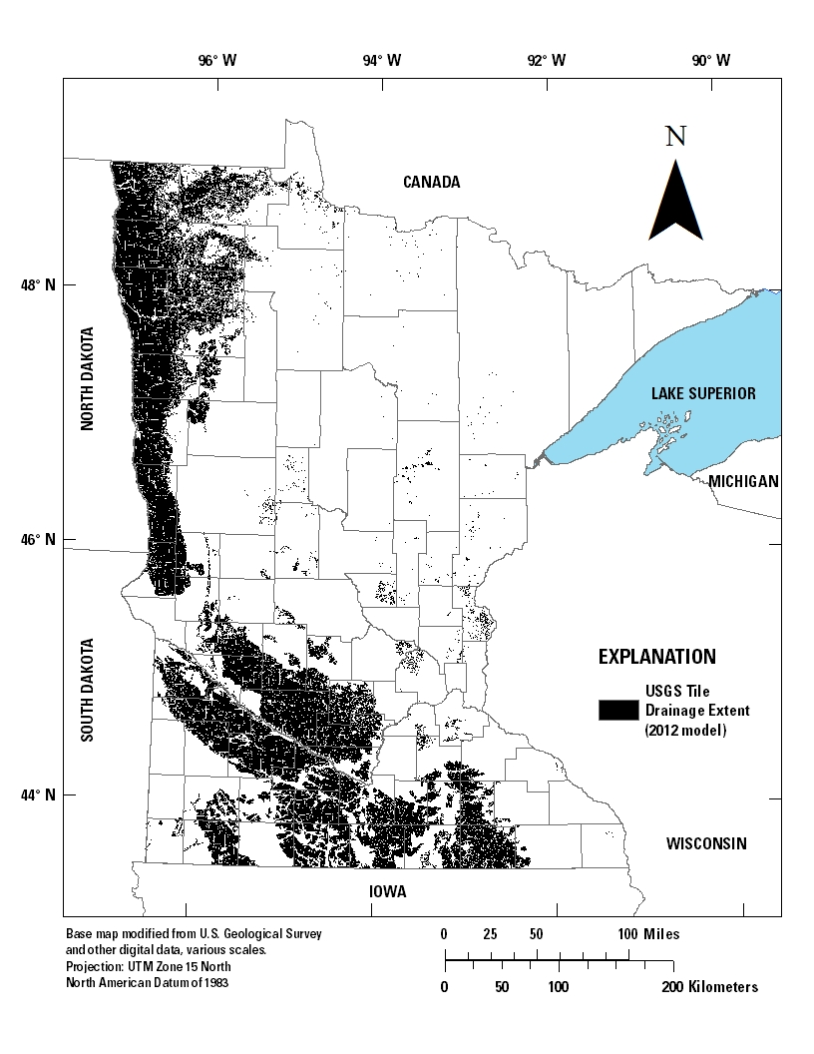
Figure 8 from paper. U.S. Geological Survey (USGS) tile drainage extent in Minnesota shown by a 30-meter raster, based on the Nakagaki and Wieczorek (2016) model of 12 Midwestern states.
Notes:
The paper discusses results of 2 different regression modeling efforts to estimate extent of tile drainage. (1) USGS model, estimating drainage extent in 2012 based on combination of estimates using STATSGO and slope, and (2) MN state agency estimate, based on LiDAR, row crop extent from the CDL, and slope < 3%. The state agency approach was somewhat ground truthed using interviews with landowners…(?)

Slide 12
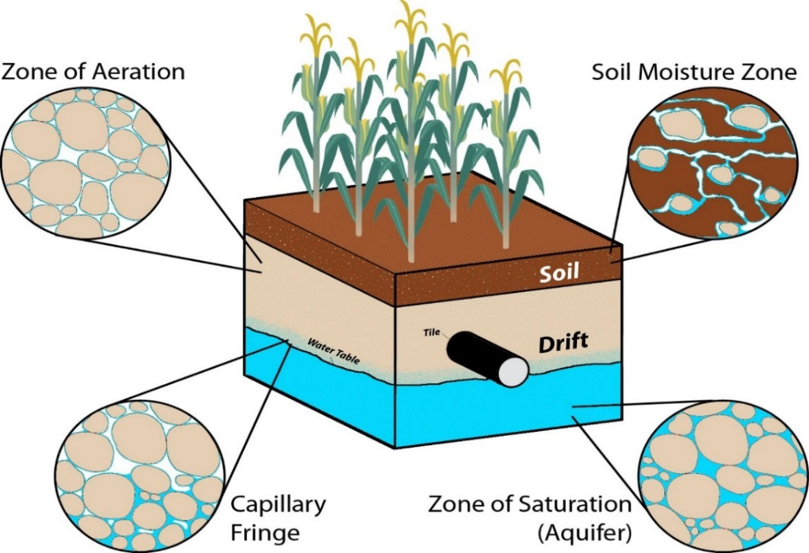
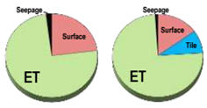
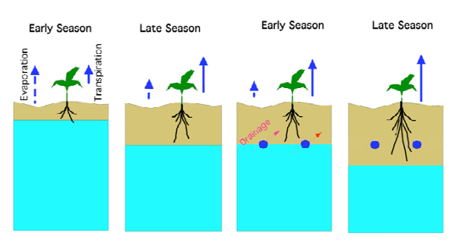
What is the effect on water budgets?
Idealized groundwater distribution in agricultural areas subject to tile drainage. The varying degrees of saturation are also shown, with the water table depth influenced by the tile drain depth (figure by B. Hoppie).
Notes:
Basically, we’re talking about the volume of water that represents the difference between the water table with and without drainage – where would that have ended up?
…often within the margin of error for the overall model
“Shallow groundwater” may refer to soil water, water table, surficial aquifer, or any “perched” water. In addition to connections to surface water, shallow groundwater may potentially have connections to buried or regional aquifers
Water budgets can be difficult to accurately quantify: substantial variations in evapotranspiration rates, infiltration rates, and the general flow of groundwater.
models are time consuming, expensive, and may not capture critical details of recharge such as the exact locations of high infiltration zones.
There is uncertainty on how much of the additional runoff to streams is from a decrease in overall evapotranspiration in agricultural watersheds versus reduced infiltration below the tile drains. E.g. under pre-settlement conditions, the landscape included abundant native vegetation and generally there was more standing water. ET has decreased during fallow periods but potentially increased during peak production. The relative magnitude of these two effects on the total water budget is unknown.
Most current relevant research focuses on monitoring the accessible parts of the water balance on already tiled areas. This research focuses on whether subsurface drainage increases or decreases evapotranspiration, increases or decreases the total runoff (both the surface and subsurface runoff), changes water storage, or affects the recharge to underlying aquifers. These components are dynamically interacting with each other. The recharge to groundwater is generally the smallest of these and is not continuous in time or space, is difficult to monitor, and likely is less than the margin of uncertainty in the measurement of the larger components. Therefore, the question of whether groundwater recharge is affected is difficult to answer, remarkably complicated, site specific, and rarely researched.
Important to understand the fate of water in the soil profile and surface depression. There are four potential fates. Soil and surface depression water can:
[click] 1: Evaporate into the atmosphere
[click] 2: Transpire is plants are actively growing
[click] 3: Infiltrate to groundwater
[click] 0r 4: drain through tile (if present)

Slide 13
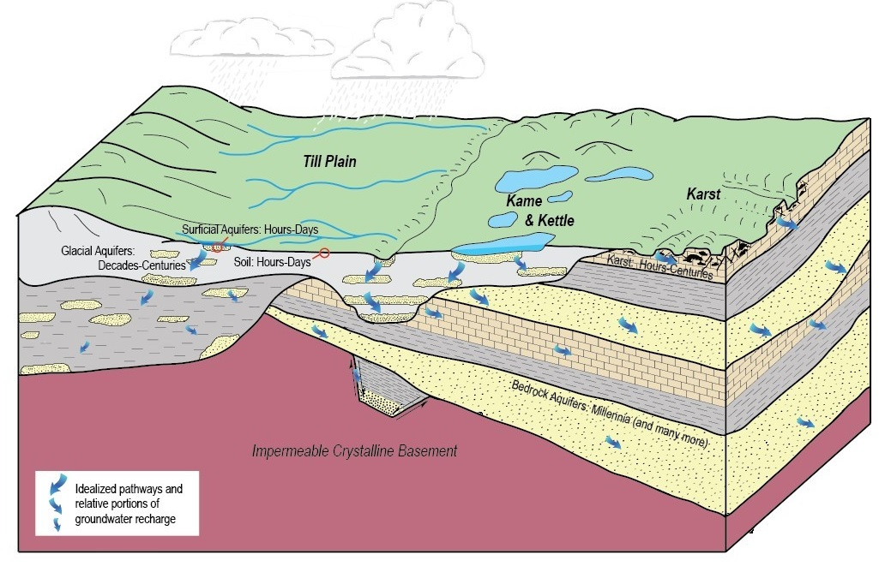
Theoretical groundwater recharge within areas prior to the influence of agricultural tile drainage. Time scales for recharge can range over several orders of magnitude, from hours and days to several thousand years. In the upper portions of the figure, the light and dark gray areas denote different glacial till layers, with interbedded sand and gravel aquifers shown in yellow. On the right side of the figure, in the karst terrain, dark gray areas with horizontal hashes denote confining layers, with interbedded sandstone (light yellow) and carbonate (dark yellow with box pattern) aquifers.
Notes:
. While soils and some surficial (water table) aquifers receive rapid, direct recharge from atmospheric and surface hydrological sources, buried glacial sands and bedrock aquifers are recharged by smaller volumes of water that are delivered slowly, periods of time of more than 1,000 to 10,000 years (Berg and Pearson, 2013). Although less commonly drained, shallow aquifers within karst terrain, shown on the right side in figure 16, have highly variable recharge rates. Some fractures support rapid recharge while unweathered and unbroken sections of carbonate rock within the overall karst region might contain water that has been virtually locked in place for tens of thousands of years.

Slide 14
From the literature review
“Drainage of former wetlands and …poorly drained soils can change the areal distribution of potential groundwater recharge and discharge.
    - Winter and others, 1998
Decreased groundwater recharge, if sustained over a long enough period or a wide spatial extent, can reduce the amount of groundwater available for long-term withdrawals in the underlying aquifers
    - Winter and others, 1998
Tile drainage is practiced where there are high water tables. High water tables cause enhanced evaporation and runoff…. For conditions of most glacial aquifers in eastern North Dakota, tile-drain waters will be captured primarily from combined evaporation and runoff.” [However] vulnerable conditions exist…
    - Schuh 2008, 2018
Notes:
Where in the state in terms of where the groundwater is, whether we’re in a recharge or a discharge area, as well as what groundwater we’re talking about. Very significant impacts on the timing and pathway of shallow groundwater making its way to lakes, rivers, streams, and wetlands in some areas. Medium potential for impacts on surficial aquifers that are in use for water supply; in this case there are probably other factors that are dominant and/or mitigating. Long-term effects on buried aquifers with limited connectivity to the surface water are likely to be very slow moving and difficult to detect, and may not even be detectable for centuries.

Slide 15
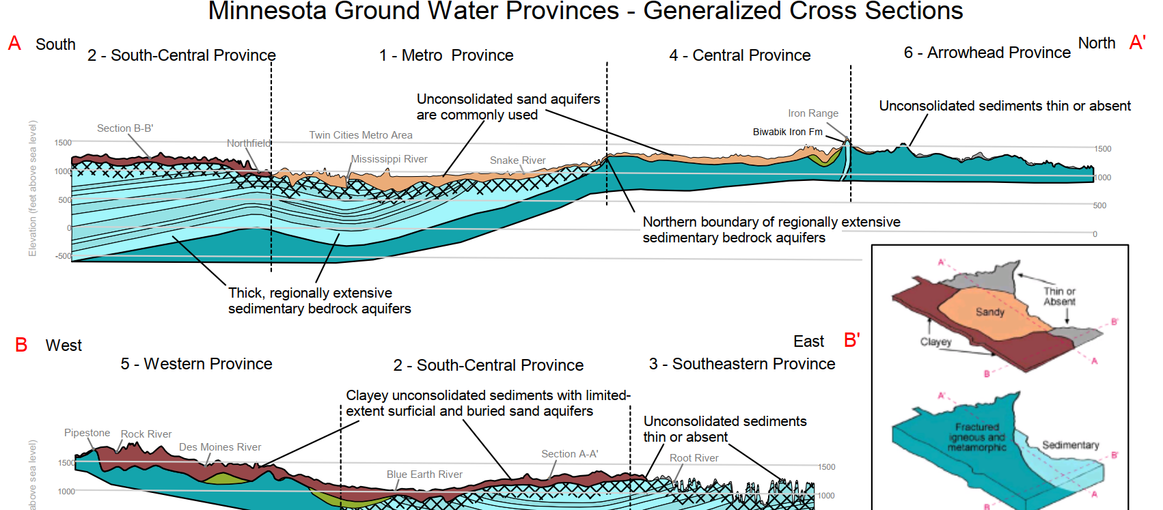
Key differences between the regions
Notes:
"The simplest and most direct answer to the question of drainage effects on hydrologic balance . . . is that in the absence of pumping, subsurface drainage will be captured from waters previously discharged through runoff, seepage to streams, evaporation and transpiration.
Tile drainage is practiced where there are high water tables. High water tables cause enhanced evaporation and runoff. Drainage, by lowering the water table, decreases evaporation and runoff. For conditions of most glacial aquifers in eastern North Dakota, tile-drain waters will be captured primarily from combined evaporation and runoff.”
“In the hydrologic cycle common to ND’s glacial aquifers, recharge occurs through precipitation and runoff (and sometimes losing streams), and discharge occurs through evaporation, transpiration, runoff, and seepage to rivers and streams.” [To be] “sustainable” withdrawal of water for human purposes (drainage or pumpage) must be recovered from existing natural discharge.
“While the estimated total annual drainage seems large, tile-drained waters are removed from an upper zone of "active" storage which is not (usually) sustainable for long-term storage. Almost all tile-drained waters would be removed through natural discharge within a year or two at most, if not drained, by seepage to surface waters or through evapotranspiration.”
“In the hydrologic cycle common to ND’s glacial aquifers, recharge occurs through precipitation and runoff (and sometimes losing streams), and discharge occurs through evaporation, transpiration, runoff, and seepage to rivers and streams.” [To be] “sustainable” withdrawal of water for human purposes (drainage or pumpage) must be recovered from existing natural discharge.
“While the estimated total annual drainage seems large, tile-drained waters are removed from an upper zone of "active" storage which is not (usually) sustainable for long-term storage. Almost all tile-drained waters would be removed through natural discharge within a year or two at most, if not drained, by seepage to surface waters or through evapotranspiration.”

Slide 16
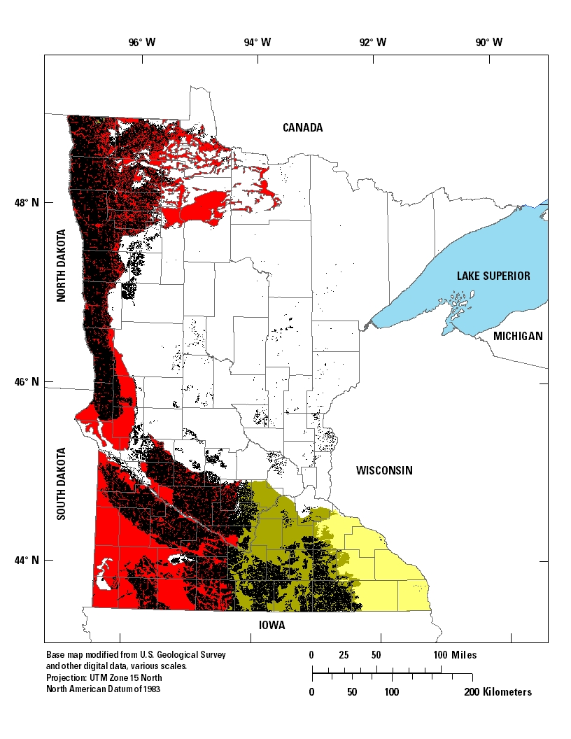
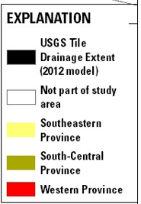
“Tile Drainage Provinces”

Slide 17
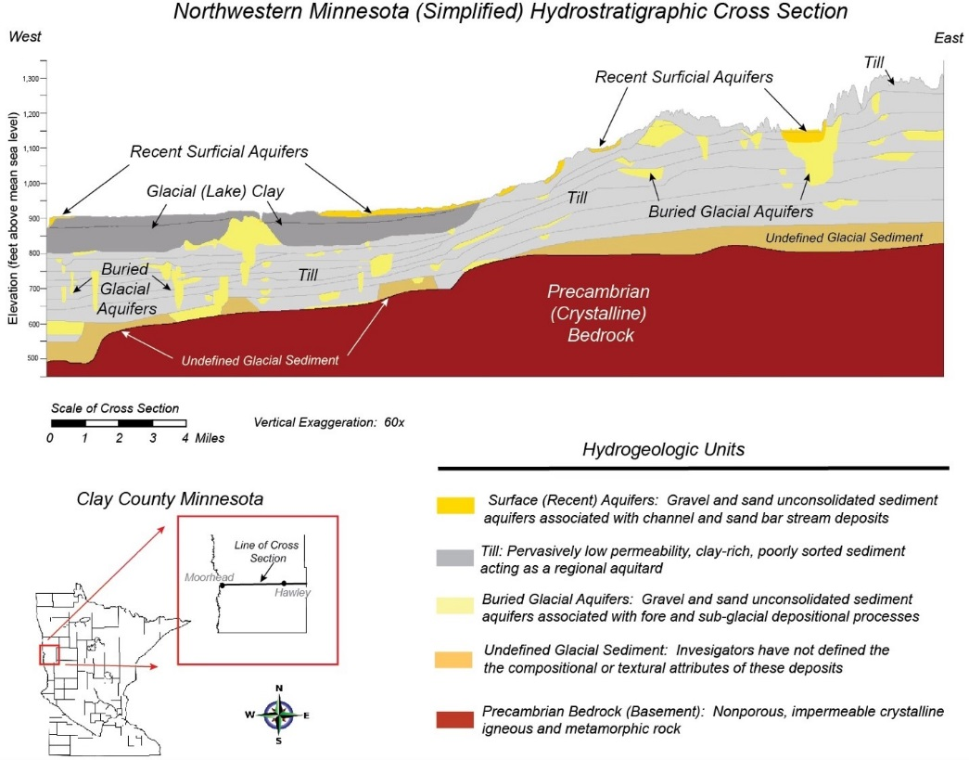
Vulnerable conditions do exist:

Slide 18
Conclusions from the paper
Knowledge Gaps & Uncertainties ➔ Opportunities to Improve Understanding & Water Management
Systematically mapping the current extent of tile; track new installation
Modeling: historical baseline & cumulative effects on water budgets
Studies to understand the effect of agricultural drainage on groundwater recharge, both quantity and quality, e.g. field-scale research farms.
  ➔ How much water is moving past the tile drain depths?
  ➔ A long-term study to understand the groundwater recharge before and after tiling.
  Innovative techniques to refine our ability to measure groundwater recharge at the field and regional scales
Notes:
Agricultural drainage is extensive across Minnesota, particularly the southern and western portions where agriculture is the dominant land use. However, detailed, up-to-date information on the extent of tile drainage does not exist.
Drainage and land use change had already extensively transformed the water budget across much of Minnesota by the time baseline information on streamflow and groundwater levels began to be collected. Therefore, the baseline data are being collected at a time when the system has already been greatly altered.
There are many different groundwater pathways. During the white paper discussions, some members referred to “shallow groundwater” as that surrounding the tile while a hydrogeologist refers to shallow groundwater as the surficial aquifer. Almost all perched water is considered shallow groundwater although it is often separate from a true regional aquifer.
Water budgets can be difficult to accurately quantify, largely due to substantial variations in evapotranspiration rates, infiltration rates, and the general flow of groundwater. Although groundwater flow can be well constrained and approximated using groundwater models, these models are time consuming, expensive, and may not capture critical details of recharge such as the exact locations of high infiltration zones. In the absence of accurate flow models, there is a lack of knowledge regarding the effect of artificial drainage on deep infiltration rates that lead to recharge of aquifers.
Related to water budgets, there is uncertainty on how much of the additional runoff to streams is from a decrease in overall evapotranspiration in agricultural watersheds versus reduced infiltration below the tile drains. For example, under pre-settlement conditions, the landscape included abundant native vegetation and generally there was more standing water. Although a row crop such as corn has a much higher evapotranspiration rate during the growing season, the change brought about by agricultural drainage that enables corn and other crop production has decreased evapotranspiration during fallow periods. The relative magnitude of these two effects on the total water budget is unknown.
Most current relevant research focuses on monitoring the accessible parts of the water balance on already tiled areas. This research focuses on whether subsurface drainage increases or decreases evapotranspiration, increases or decreases the total runoff (both the surface and subsurface runoff), changes water storage, or affects the recharge to underlying aquifers. These components are dynamically interacting with each other. The recharge to groundwater is generally the smallest of these and is not continuous in time or space, is difficult to monitor, and likely is less than the margin of uncertainty in the measurement of the larger components. Therefore, the question of whether groundwater recharge is affected is difficult to answer, remarkably complicated, site specific, and rarely researched.

Slide 19
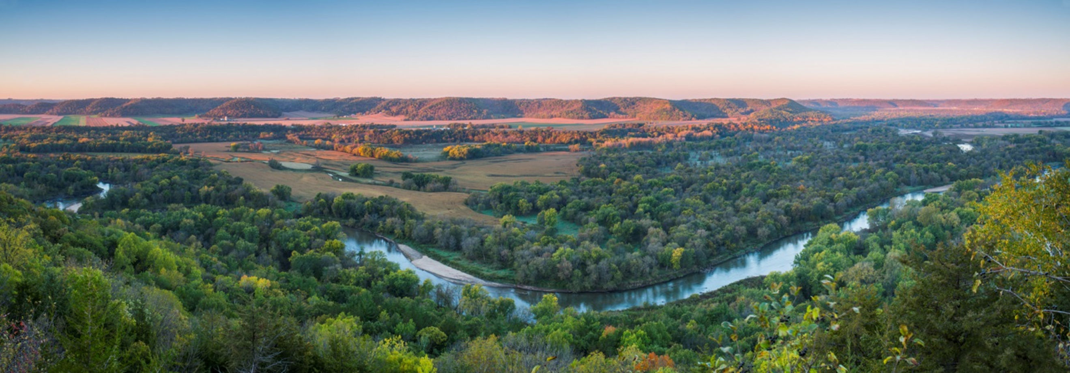
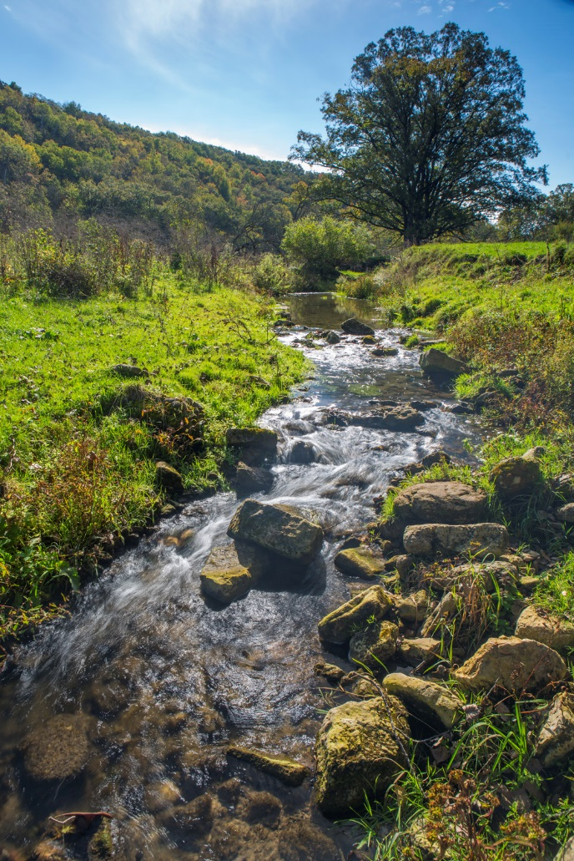
Questions?
Notes:
A risk assessment (re: tile expansion) could be conducted based on an overlay of the following available layers:
Areas where surficial aquifers represent important water supply
Areas where groundwater monitoring shows relatively recent recharge (based on tritium concentrations)
Areas where the water table elevation of drainage is close to the potentiometric surface of groundwater in buried aquifers
Areas identified as having focused recharge occurring
Areas where there are numerous or high-risk wells drawing from deeper aquifers

